Slide 1
INCA Tool Beta 2 Training for Ecosystem Services Partnership (ESP) 2022 Europe
INCA
Heraklion, Greece – ESP 2022 Europe
10/10/2022
Mayra Zurbaran
Alessandra La Notte
Ioanna Grammatikopoulou
Bruno Smets (VITO)

Slide 2

First of all: get the data
Getting started: download the data & software
QGIS (LTR): https://www.qgis.org/en/site/forusers/download.html
INCA Plugin Beta 2 + datasets: https://tinyurl.com/espinca2022
  Unzip the downloaded data

Slide 3
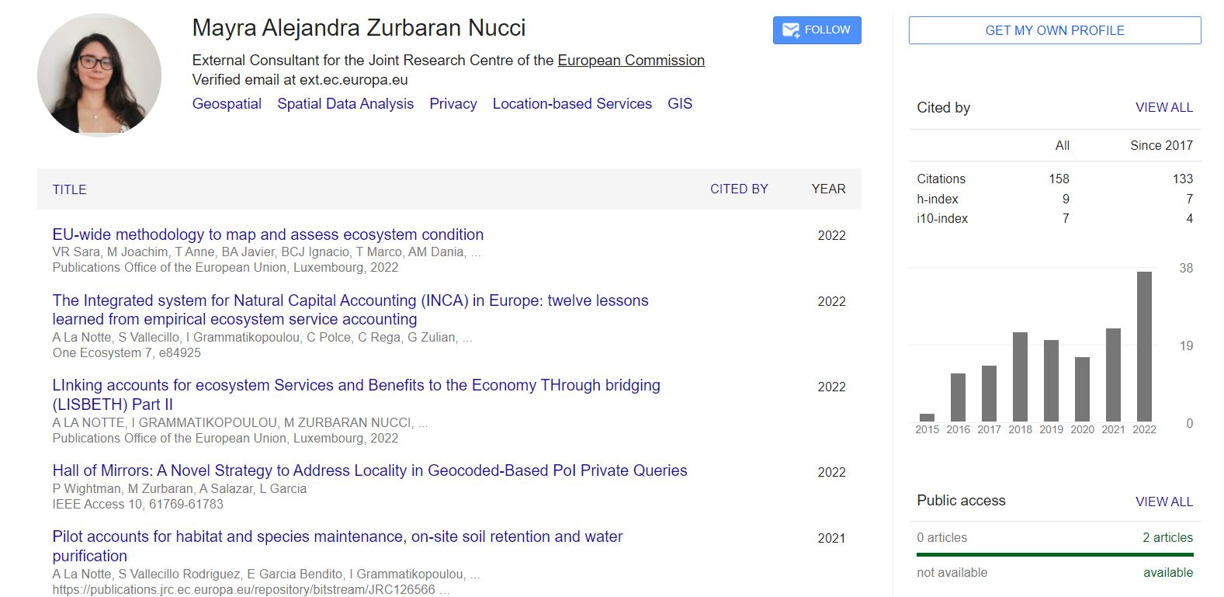
Mayra A. Zurbaran Nucci
Recent Experience
External Consultant at the Joint Research Centre of the European Commission
Research fellow at the Geomatics and Earth Observation laboratory (GEOlab) of Politecnico di Milano, Milan, Italy
PhD in Computer Science, cum laude from Universidad del Norte, Barranquilla, Colombia
Contributions & Projects
Supported and collaborated for the “EU-wide methodology to map and assess ecosystem condition” at EU level
Data manager and support to the INCA Platform and the INCA project
Authored the PostGIS Cookbook 2nd Edition
Enabled Hotspot Analysis functionalities for the QGIS project
https://scholar.google.com/citations?hl=en&user=W2DqfNIAAAAJ&view_op=list_works&sortby=pubdate

Slide 4
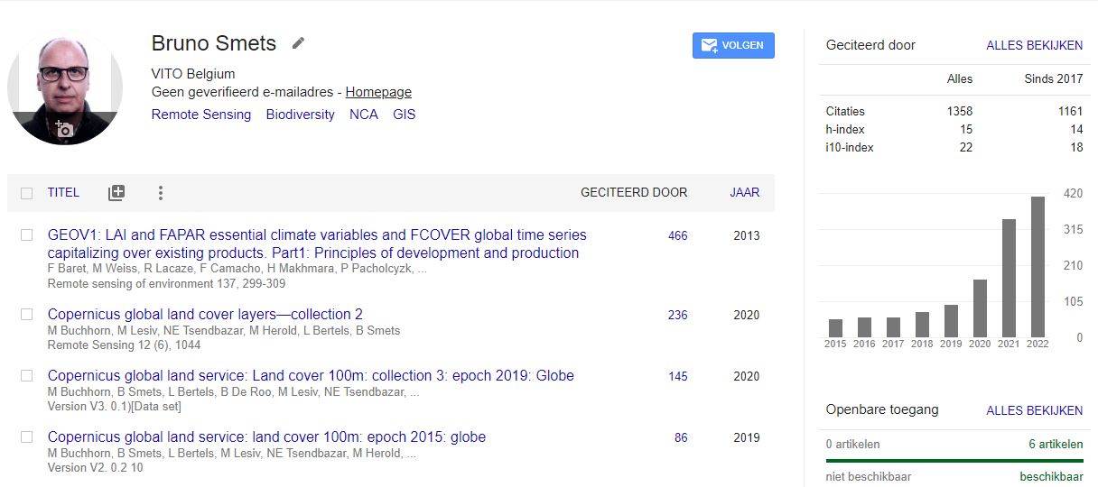
Bruno Smets
Recent Experience
Lead Natural Capital Accounting team VITO
Lead Copernicus Land Services VITO
Multi-media expert NXP Semiconductors
Contributions & Projects
Lead contractor to support the INCA project for Eurostat, development of INCA tool and guidelines
Lead contractor to integrate Earth Observation in Ecosystem Accounting for land and freshwater, ESA project
Remote sensing for biodiversity monitoring, Habitat mapping, EuropaBON project
Natural Capital Accounting for protected areas in West-Africa, IUCN project
Copernicus High Resolution Vegetation Phenology and Productivity
https://scholar.google.at/citations?hl=nl&view_op=list_works&gmla=AJsN-F7ErVsYhwDx6770NBRjnv21EpC2SRjIowvHwnfGNeD5Q0T-5VZIQq_dAZ7qmDZbRxXXnJ4gVDpOirQJN6_EtlyC19fJ3kHe568Il6y9-Ff3ov9loWc&user=Ll1OkFcAAAAJ

Slide 5
INCA project
The European Commission supported the UN in the development of this framework with contributions from scientists, statisticians, and policymakers throughout the Knowledge Innovation Project on Integrated Natural Capital Accounting (INCA)
The INCA project is jointly undertaken by European Commission services (Eurostat, the Joint Research Centre, DG Environment and DG Research and Innovation) and the European Environment Agency
INCA addresses key policy objectives of the EU. In the context of the European Green Deal, the EU Biodiversity Strategy for 2030 is calling for the establishment of an international natural capital accounting initiative
The first designing phase of INCA took place in 2015. The objective of the second phase of INCA (2016-2020) was to build pilot accounts at EU level on ecosystem extent, condition and on nine ecosystem services
The third phase of INCA (started in 2021), the pilot applications tested in phase two are becoming concrete tools and operational guidelines which enable practitioners to run on a regular basis ecosystem services accounts
Read more: https://ecosystem-accounts.jrc.ec.europa.eu/about-inca

Slide 6
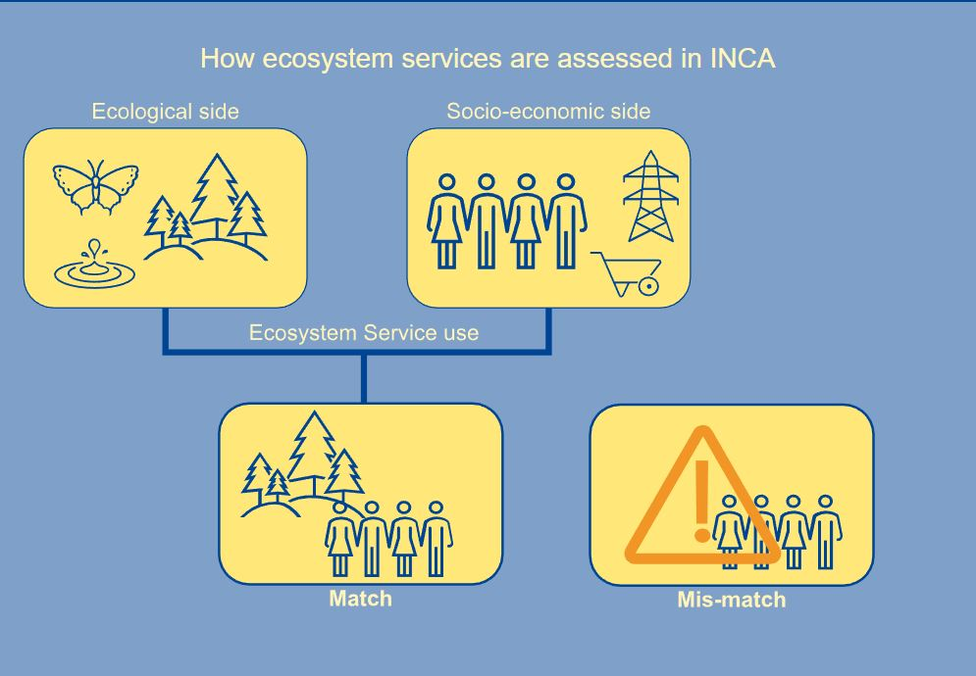
INCA approach
Read more: https://ecosystem-accounts.jrc.ec.europa.eu/about-inca

Slide 7
INCA approach
The ecosystem service potential represents the ecological side that quantifies what ecosystems can provide, independently whether there is a use or not
The ecosystem service demand is the socio-economic side of ecosystem services that can entail economic sectors (such as agriculture, manufacturing, utility suppliers), households and (when we deal with overarching environmental targets such as climate change and biodiversity loss) the global society
When the ecosystem service potential matches with the ecosystem service demand, an ecosystem service actual flow (use) is generated. This is the flow reported in Supply and Use tables
When the ecosystem service potential does not match with the ecosystem service demand, we can identify three different types of mis-matches:
  unmet demand: the absence of ecosystem able to provide the services
  overuse: the use of the service which exceeds its regeneration or absorption rates
  missed flow: the gap existing between what could be currently provided and what is effectively provided
Ecosystem services mis-matches accounts are complementary information and thus are not reported in official Supply and Use tables. However, they remain key to assess ecosystem and ecosystem services vulnerabilities
Read more: https://ecosystem-accounts.jrc.ec.europa.eu/about-inca

Slide 8

Disclaimer: INCA Tool is still under development and this beta 2 release is an intermediate version of the final plugin. On this note, issues on the installation or running of the plugin may arise given the configuration options. Follow the instructions carefully. DO NOT DISTRIBUTE.
Image copyright (CC BY 4.0): picture by A. La Notte

Slide 9
Requirements
QGIS 3.22.11 (Long Terms Release – LTR)
INCA plugin beta 2
Administrative rights on your machine
Knowledge with GIS tools is desired

Slide 10
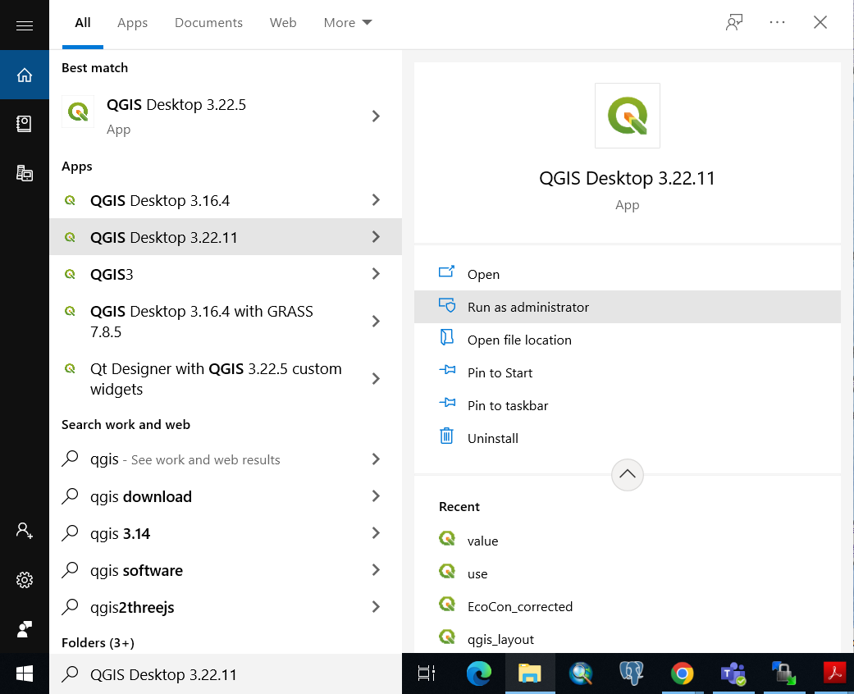
Open QGIS 3.22.11 (LTR) as administrator
Right-click on QGIS LTR and select ‘Run as administrator’ for the plugin installation. Once installed, this will not be needed

Slide 11
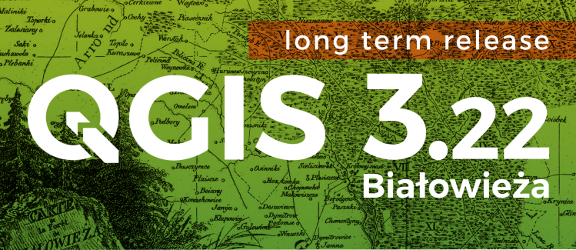
QGIS 3.22 (LTR) - A Free and Open Source Geographic Information System
Download: https://qgis.org/downloads/QGIS-OSGeo4W-3.22.11-1.msi

Slide 12
About QGIS
QGIS is a professional GIS application that is built on top of and proud to be itself Free and Open Source Software (FOSS)
Licensed under the GNU General Public License. QGIS is an official project of the Open Source Geospatial Foundation (OSGeo)
  OSGeo is a not-for-profit organization whose mission is to foster global adoption of open geospatial technology by being an inclusive software foundation devoted to an open philosophy and participatory community driven development
QGIS provides a continuously growing number of capabilities provided by core functions and plugins
You can visualize, manage, edit, analyse data, and compose printable maps

Slide 13
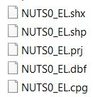

Spatial data types used (vector & raster)
Vector files are geometries that can be points, lines, polygons or multipolygons
  Vector files we are going to use are shapefiles - a format by esri
  A shapefile is composed by at least 4 different single files. All are needed
  Example for NUTS0 for Greece:
  When selecting a shapefile make sure to select the one with the .shp extension
Learn more: https://desktop.arcgis.com/en/arcmap/latest/manage-data/shapefiles/shapefile-file-extensions.htm
Raster files consists of a matrix of cells (or pixels) organized into rows and columns (or a grid) where each cell contains a value representing information
  Raster files we are going to use are GeoTIFF: public domain metadata standard which allows georeferencing information to be embedded within a TIFF file
  Example for CORINE Land Cover Accounting Layer for 2018:
  When selecting a raster make sure to select the one with the .tif extension
  The .aux file stores auxiliary metadata for the raster file (.tif)

Slide 14
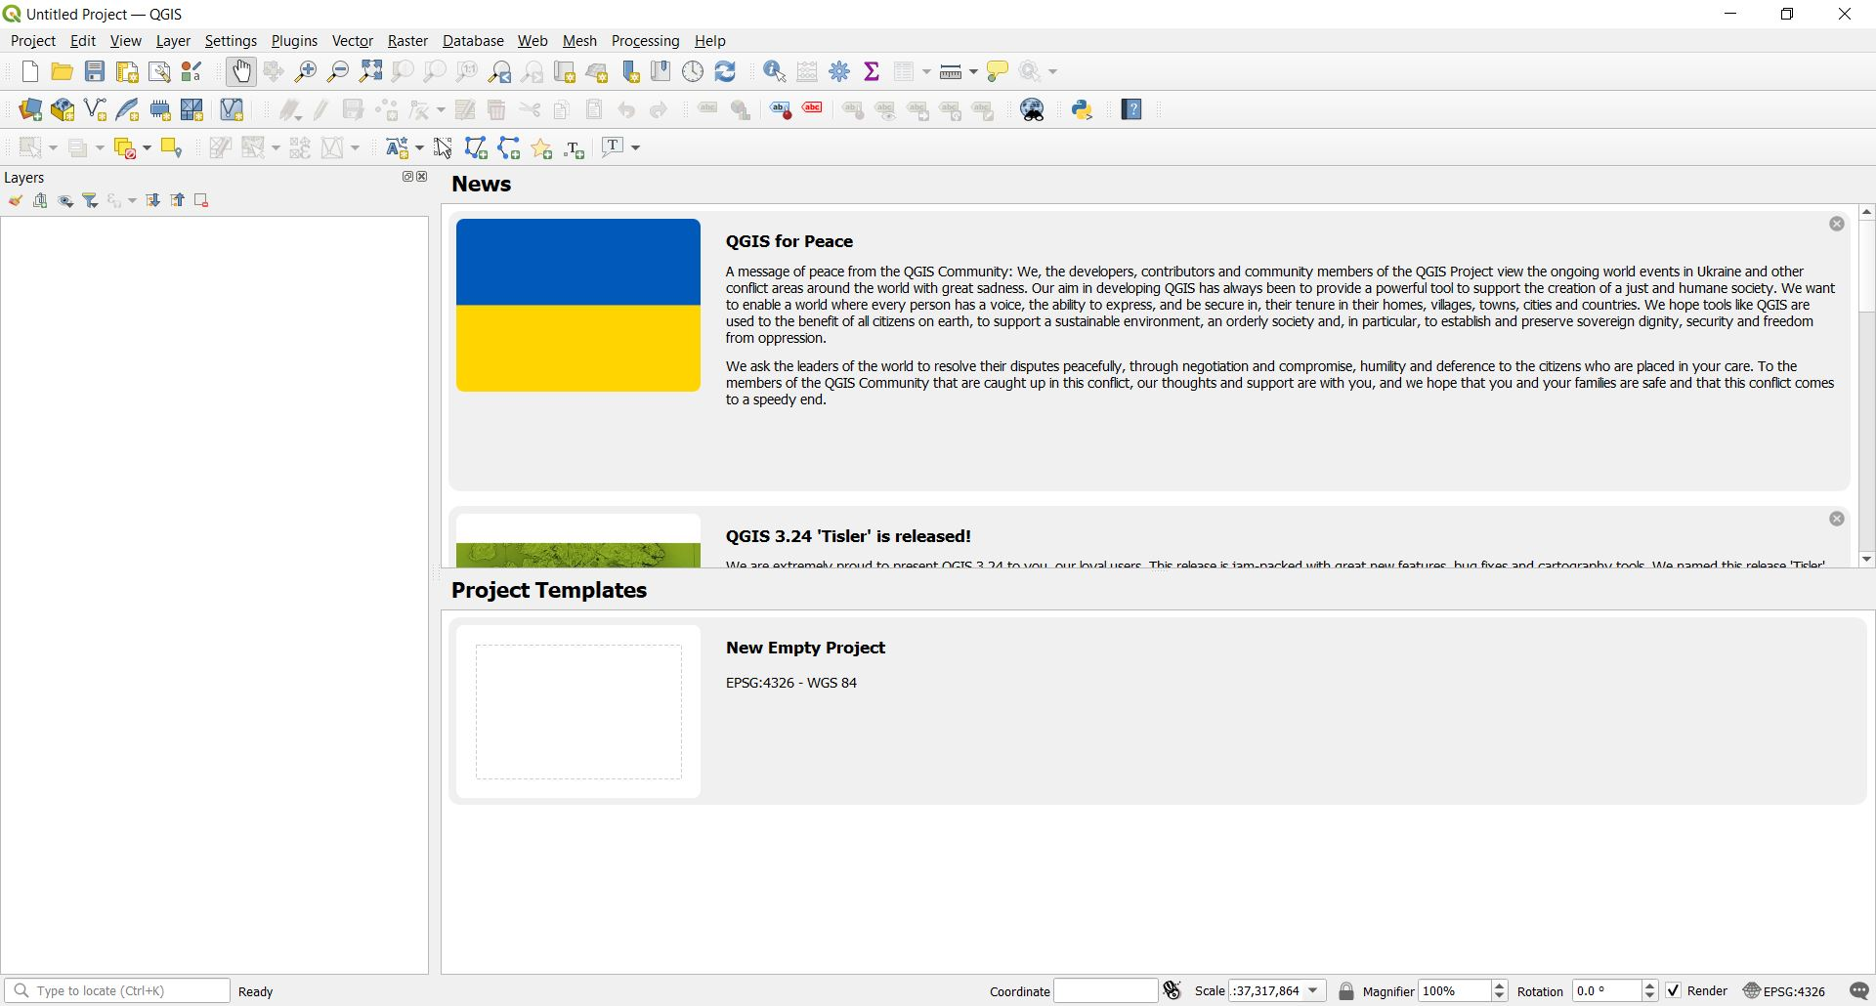
Get familiar
Where you will manage plugins
The main element of the processing GUI. We’ll use this later. If not present install/activate it through the ‘Plugin Manager’
All your spatial data (layers) will appear here. The order in which they show up is the way they are overlapped in the project

Slide 15
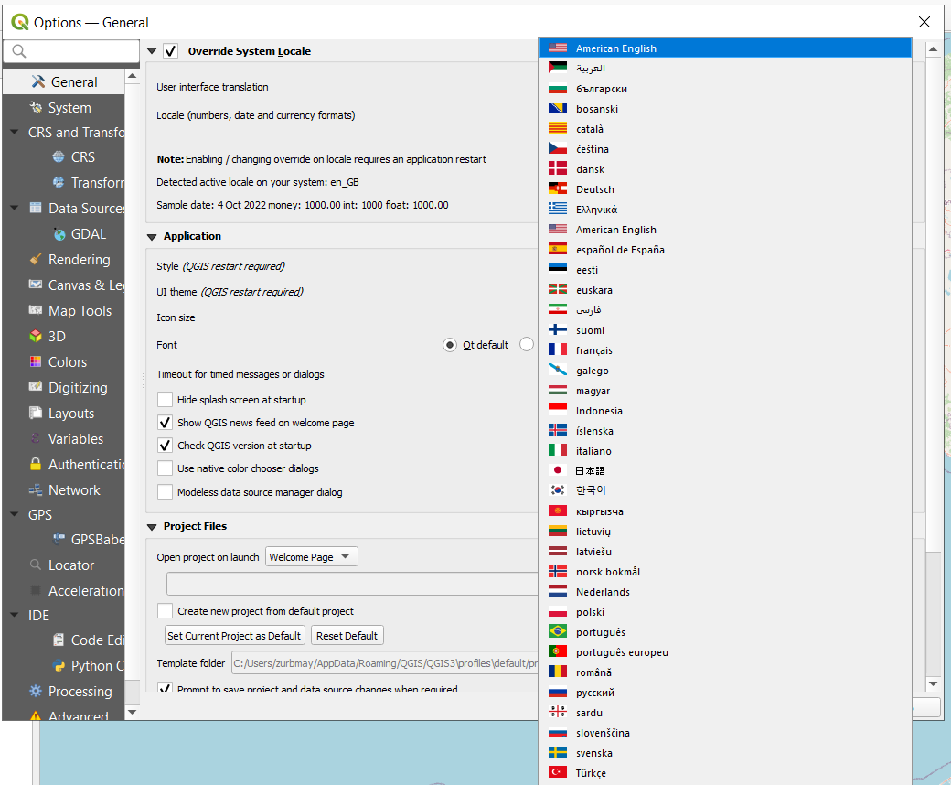
Set language to ‘American English’
Select from the menu ‘Settings’ then ‘Options...’
Select ‘General’
Tick ‘Override System Locale’ and select ‘American English’ for the ‘User interface translation’
Click on ‘OK’ and restart QGIS

Slide 16
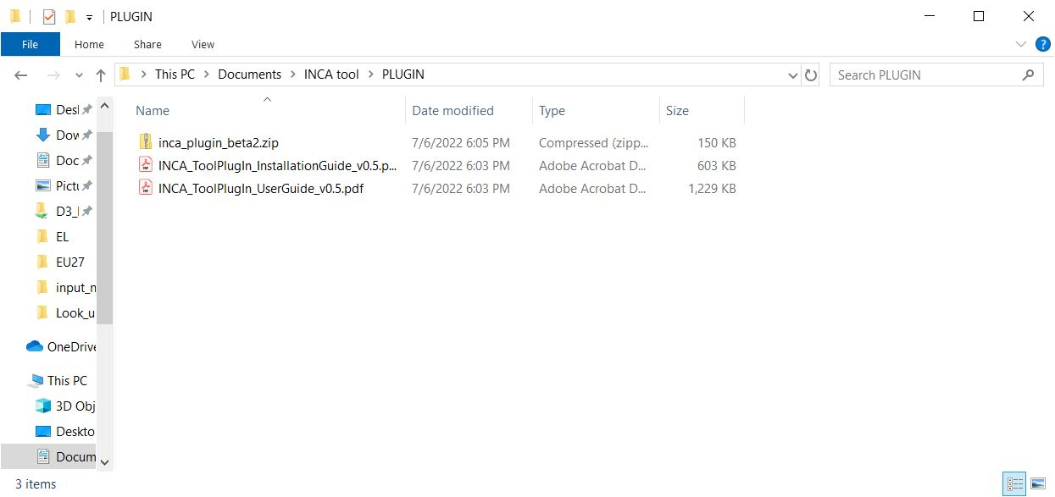
Check the files shared with you under ‘PLUGIN’
Then INCA plugin – Do NOT unzip
Installation guide for different OS. If you’re not running Windows, follow instructions from here
User guide for different models, you can consult this for extra information on configuration later on

Slide 17
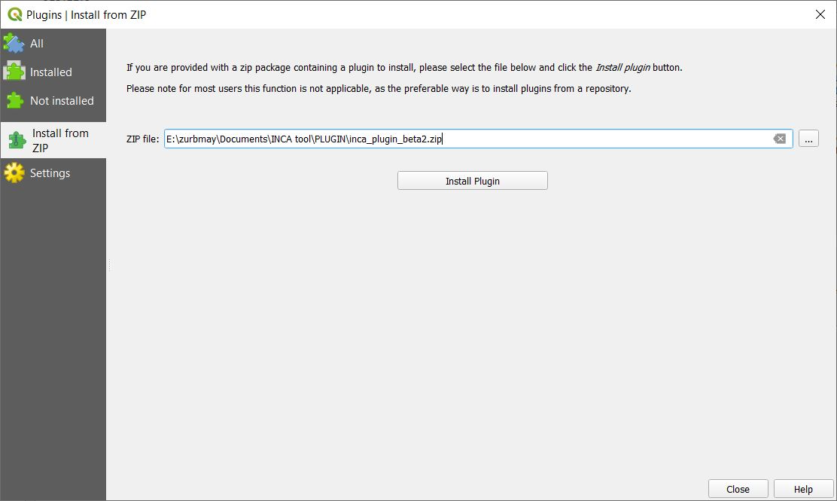
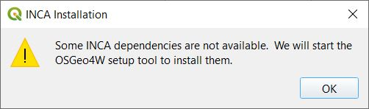
Search the plugin and start installation
Do not unzip the plugin file
Go to ‘Plugins’ > ‘Manage and Install Plugins…’
Select ‘Install from ZIP’ and search for the INCA beta 2 zip and select it
Where you stored the INCA beta 2 zip file in your computer.
Use your OS drive (e.g.’C:\...’
Click to start the installation

Slide 18
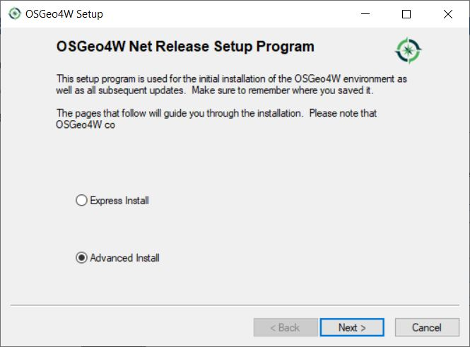
Continue to install dependencies with OSGeo4W – Windows only

Slide 19
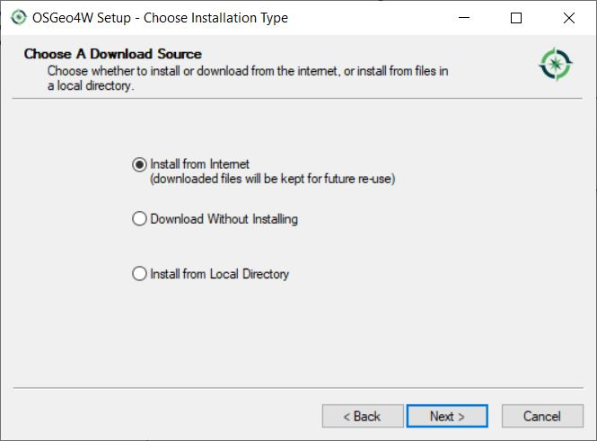
Continue to install dependencies with OSGeo4W – Windows only

Slide 20
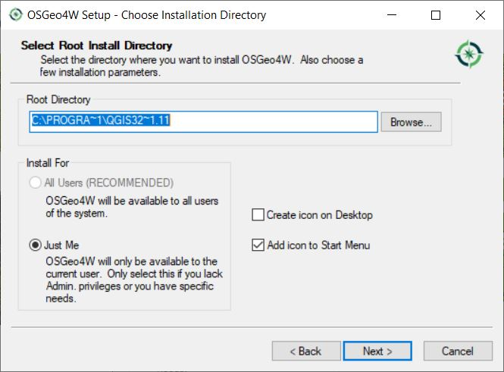
Continue to install dependencies with OSGeo4W – Windows only

Slide 21
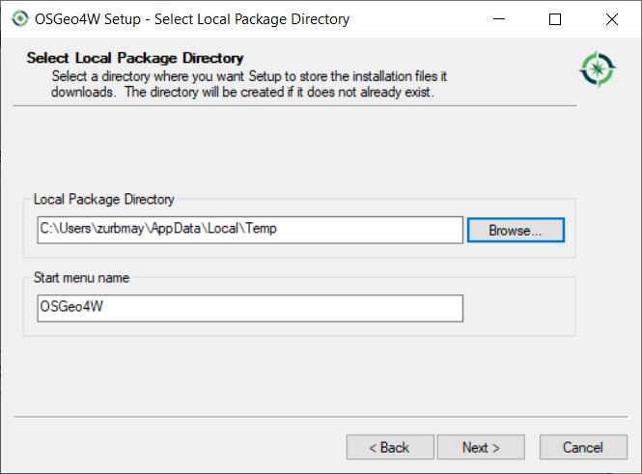
Continue to install dependencies with OSGeo4W – Windows only

Slide 22
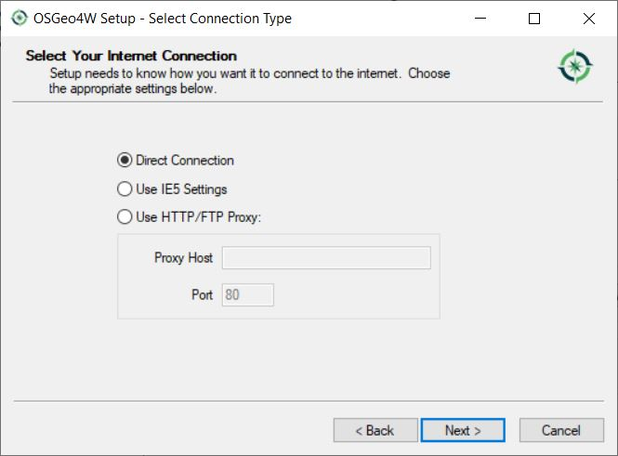
Continue to install dependencies with OSGeo4W – Windows only

Slide 23
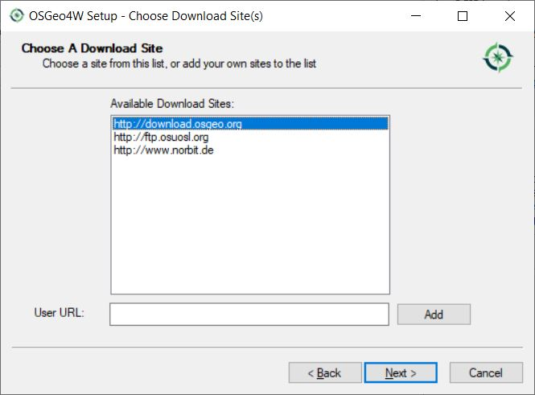
Continue to install dependencies with OSGeo4W – Windows only

Slide 24
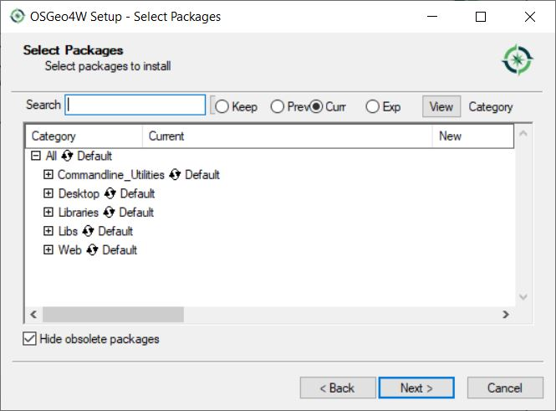
Continue to install dependencies with OSGeo4W – Windows only
INCA has already selected all packages needed. Click on ‘Next’

Slide 25
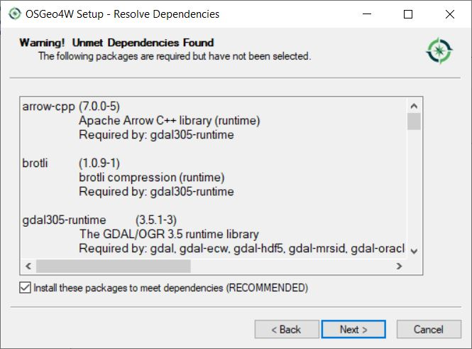
Continue to install dependencies with OSGeo4W – Windows only
If this dialog appears, make sure the checkbox is ticked and click on ‘Next’. Missing dependencies will be installed.

Slide 26
Continue to install dependencies with OSGeo4W – Windows only
After installing dependencies successfully this dialog appears. Click ‘Finish’

Slide 27
Continue to install dependencies with OSGeo4W – Windows only
After installing dependencies from OSGeo4W, some Python packages need to be installed. If you require a proxy, tick the box to set the configuration, otherwise, click ‘OK’

Slide 28
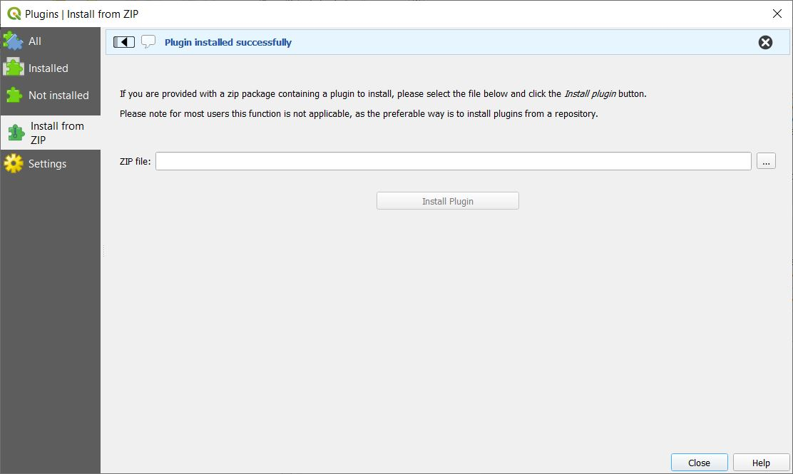
INCA installation complete
Now, restart QGIS

Slide 29
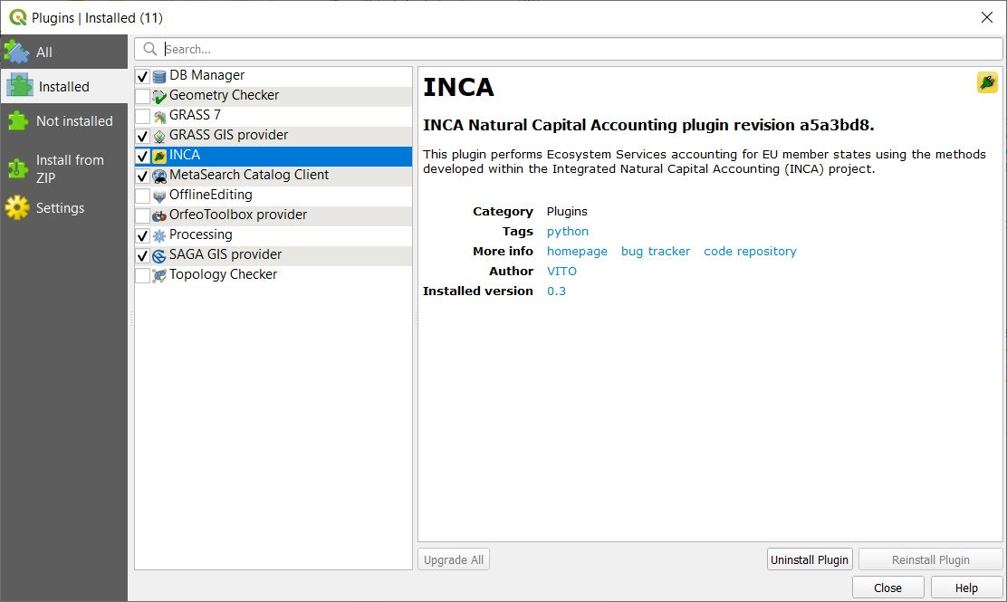
Activate the INCA plugin
To activate the plugin:
  Go again to ‘Plugins’ > ‘Manage and Installed Plugins…’
  Select ‘Installed’
  Tick the checkbox for INCA or make sure it is selected and close the window

Slide 30
Show the INCA plugin
To show INCA:
  Go to ‘Plugins’ > ‘INCA’ > ‘Calculate NCA’

Slide 31
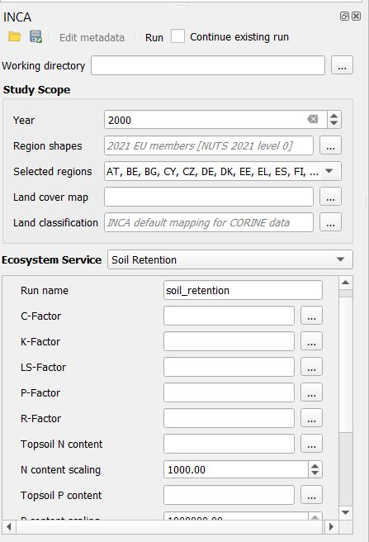
INCA Tool: get familiar – soil retention
Specify a ‘Working directory’. All the outputs of the model will be stored there. Make sure QGIS has access to this directory.
The ‘ Study Scope’ defines the year(s), shapefile for the regions, land cover map (raster) to delimit the extent of ecosystems and the classification (table).
You can keep these settings fixed for different models.
Select an ‘Ecosystem Service’ model to run. Let’s start with ‘Soil Retention’. Parameters below will adjust depending on this selection.
This will be the name of the output folder of the model. Make sure this folder doesn’t exist if you’re doing a first run for the model - which is the case!
Required inputs for the model selected. We will use the default data used for the calculation of EL (Greece) for 2018.

Slide 32
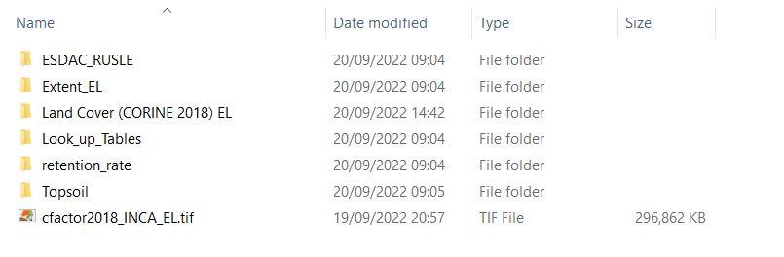
INCA Tool: explore the DATA – (on-site) soil retention

Slide 33
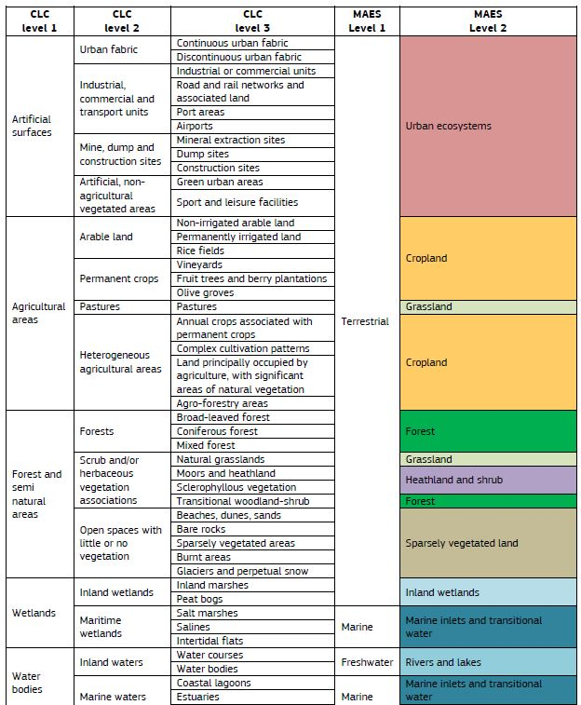
INCA Tool: MAES classification from CORINE

Slide 34
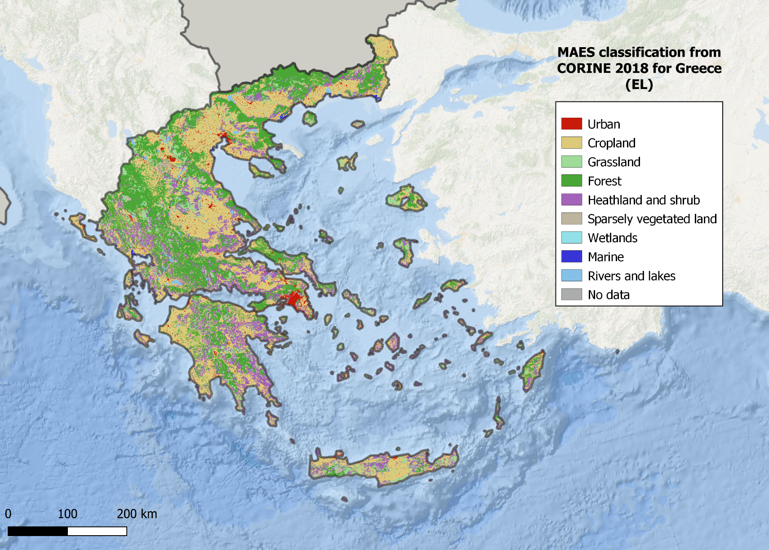
INCA Tool: MAES classification from CORINE Land Cover for Greece (EL)

Slide 35
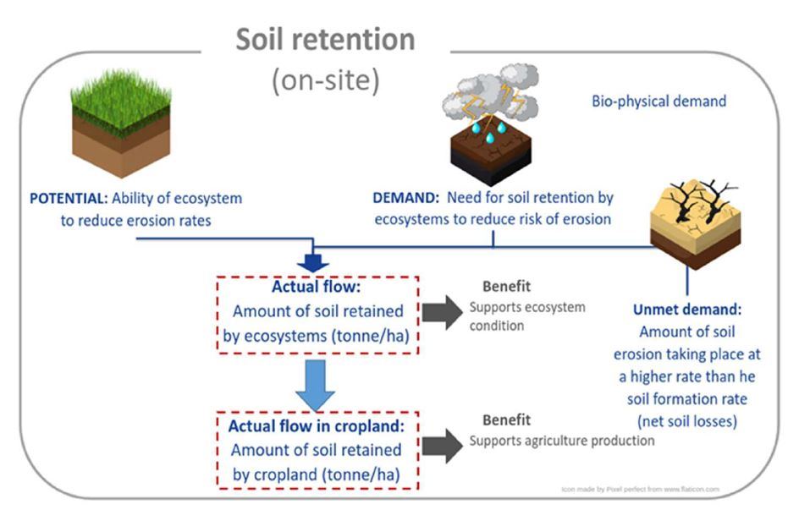
On-site soil retention flows
Image copyright (CC BY 4.0): La Notte, A., Vallecillo Rodriguez, S., Garcia Bendito, E., Grammatikopoulou, I., Czucz, B., Ferrini, S., Grizzetti, B., Rega, C., Herrando, S., Villero, D., Zurbaran Nucci, M. and Maes, J., Ecosystem Services Accounting – Part III - Pilot accounts for habitat and species maintenance, on-site soil retention and water purification, EUR 30856 EN, Publications Office of the European Union, Luxembourg, 2021, ISBN 978-92-76-42051-4, doi:10.2760/636621, JRC126566.

Slide 36
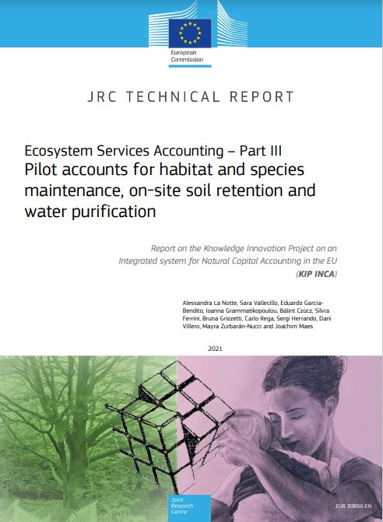

INCA: soil retention - RUSLE
R-Factor: rain erosivity
LS-Factor: slope length and angle
Rate of soil erosion
$$A=R∙K∙LS∙C∙P$$
P-Factor: anthropogenic support practices
K-Factor: soil erodibility
C-Factor: vegetation cover factor
More info
“Ecosystem Services Accounting – Part III - Pilot accounts for habitat and species maintenance, on-site soil retention and water purification”
La Notte, A., Vallecillo Rodriguez, S., Garcia Bendito, E., Grammatikopoulou, I., Czucz, B., Ferrini, S., Grizzetti, B., Rega, C., Herrando, S., Villero, D., Zurbaran Nucci, M. and Maes, J., Ecosystem Services Accounting – Part III - Pilot accounts for habitat and species maintenance, on-site soil retention and water purification, EUR 30856 EN, Publications Office of the European Union, Luxembourg, 2021, ISBN 978-92-76-42051-4, doi:10.2760/636621, JRC126566.

Slide 37
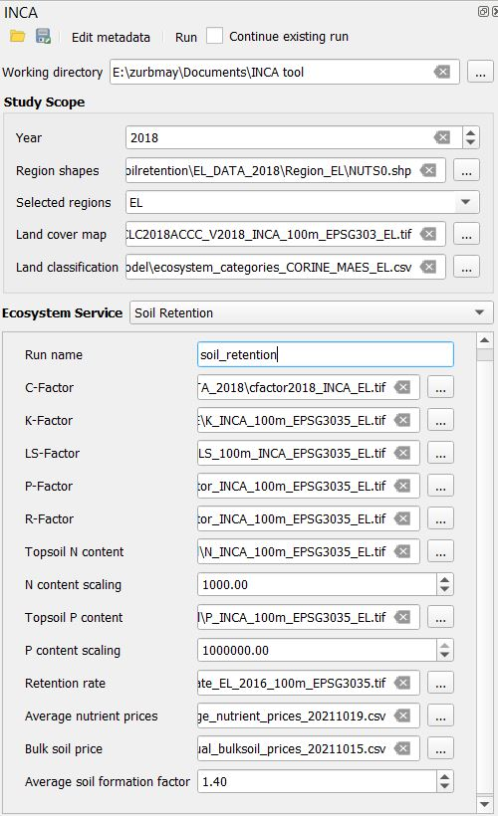


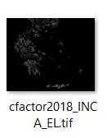


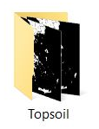


INCA Tool: soil retention inputs
You may find all the required inputs in the ‘EL_DATA_2018’ folder under DATA > input_model_soilretention > input_model
Note that the shapefile for the Region does not change, this file is under ‘DATA’
Use .shp extenshion
After all inputs are in place you are ready to run the model!
Optional when using CORINE Accounting Layers
Leave default values
Leave default value

Slide 38
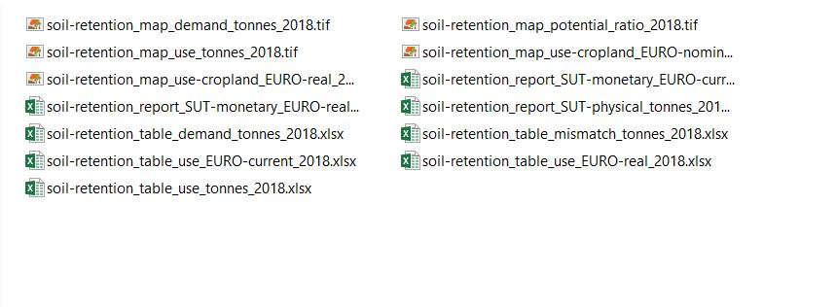
INCA Tool: soil retention – explore results
‘results’ folder under the name of you run

Slide 39
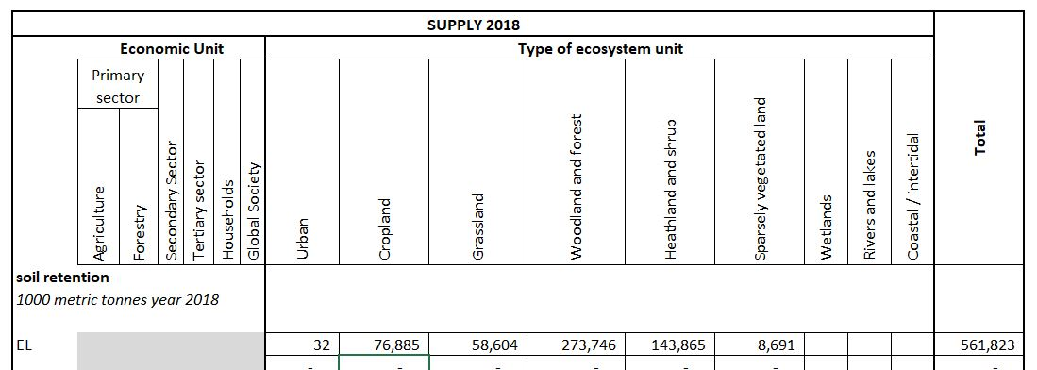
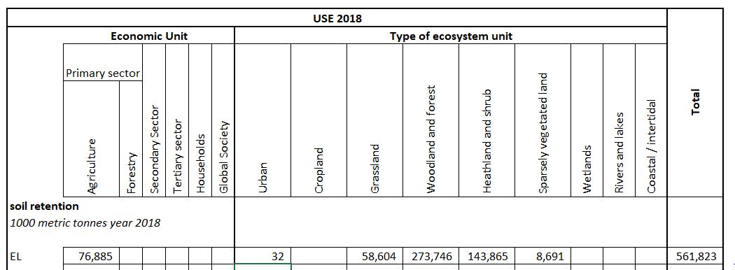
Supply and use tables in biophysical terms
*A known issue with the allocation occurs. To get the correct supply and use tables make sure that the ‘SUPPLY’ sheet references correctly the matching ecosystems in raw_data

Slide 40
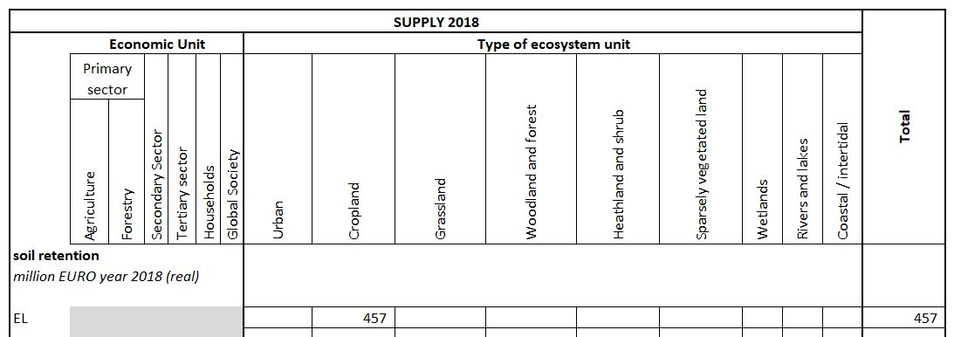
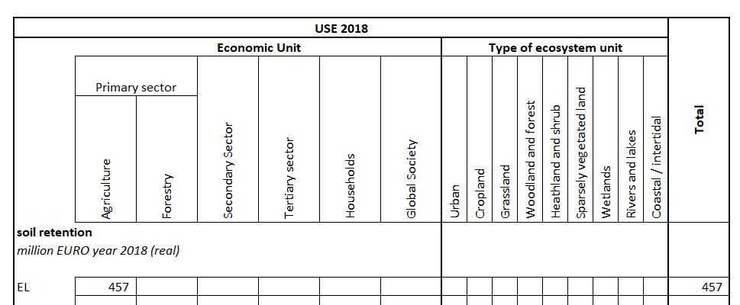
Supply and use tables in monetary terms (real)

Slide 41
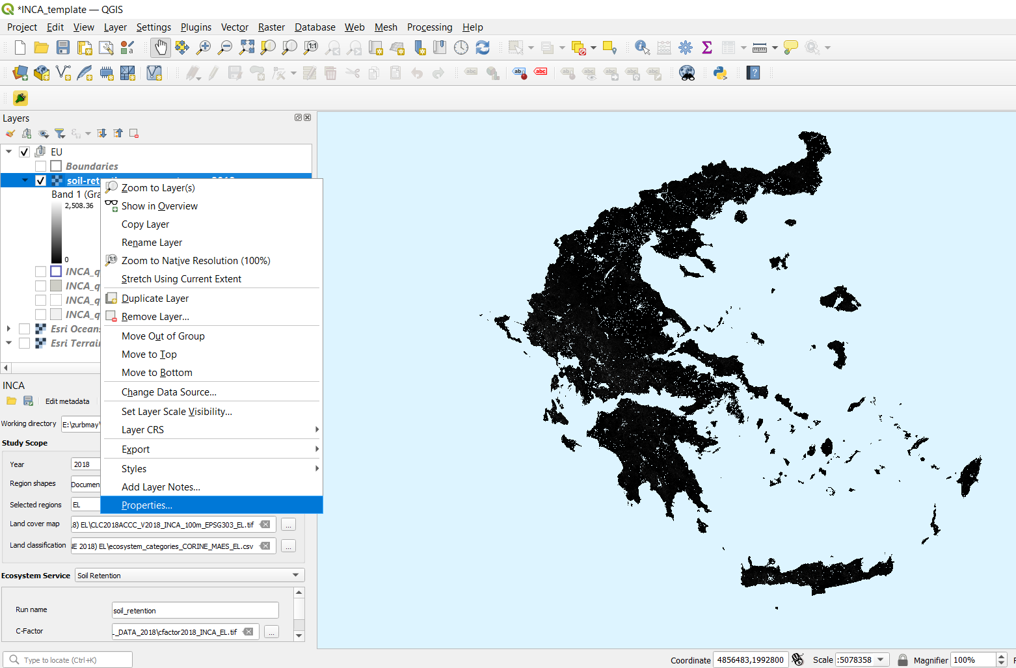
QGIS: adjust soil retention use visualisation
Right-click on the:
‘soil-retention_map_use_tonnes_2018’ raster layer and then ‘Properties...’

Slide 42
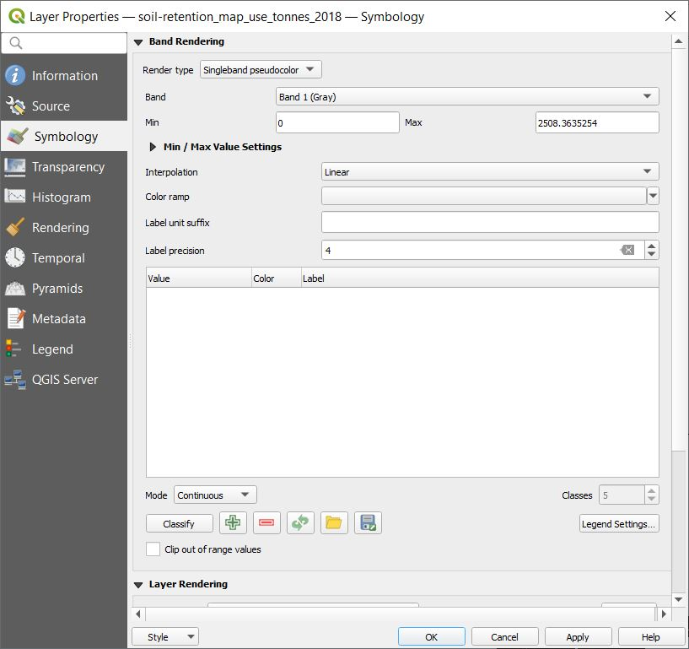
QGIS: adjust soil retention use visualisation
Select ‘Symbology’ and as ‘Render type’ select ‘Singleband pseudocolor’

Slide 43
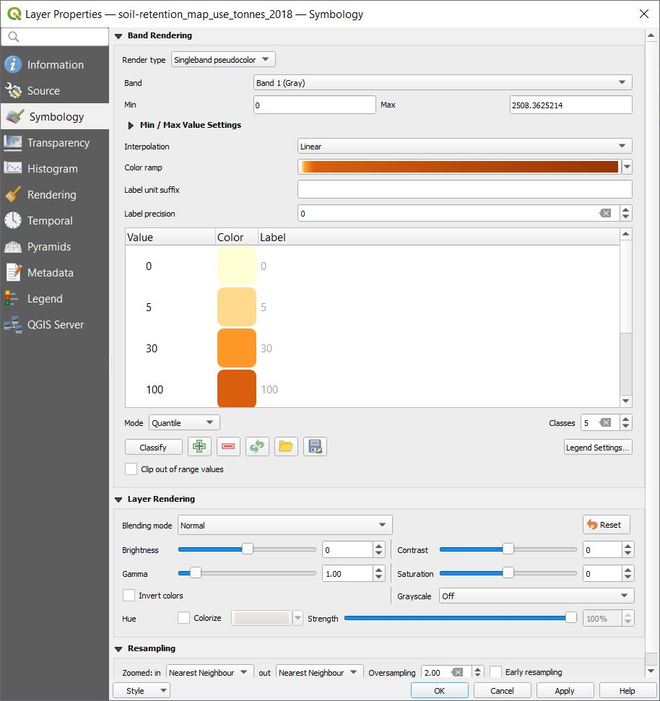
QGIS: adjust soil retention use visualisation
Choose a ‘Color ramp’
Set the classification mode to ‘Quantile’ and the number of ‘Classes’ to 5
Round the values and decrease the ‘Label precision’ to 0
Click ‘Apply’ then ‘OK’

Slide 44
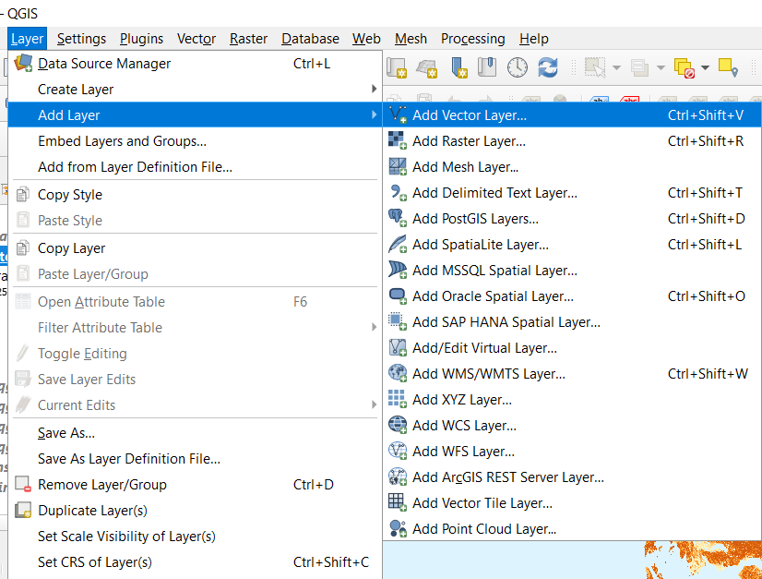
QGIS: adjust soil retention use visualisation
Choose ‘Layer’ from the menu then click on ‘Add Layer’ and then on ‘Add Vector Layer’

Slide 45
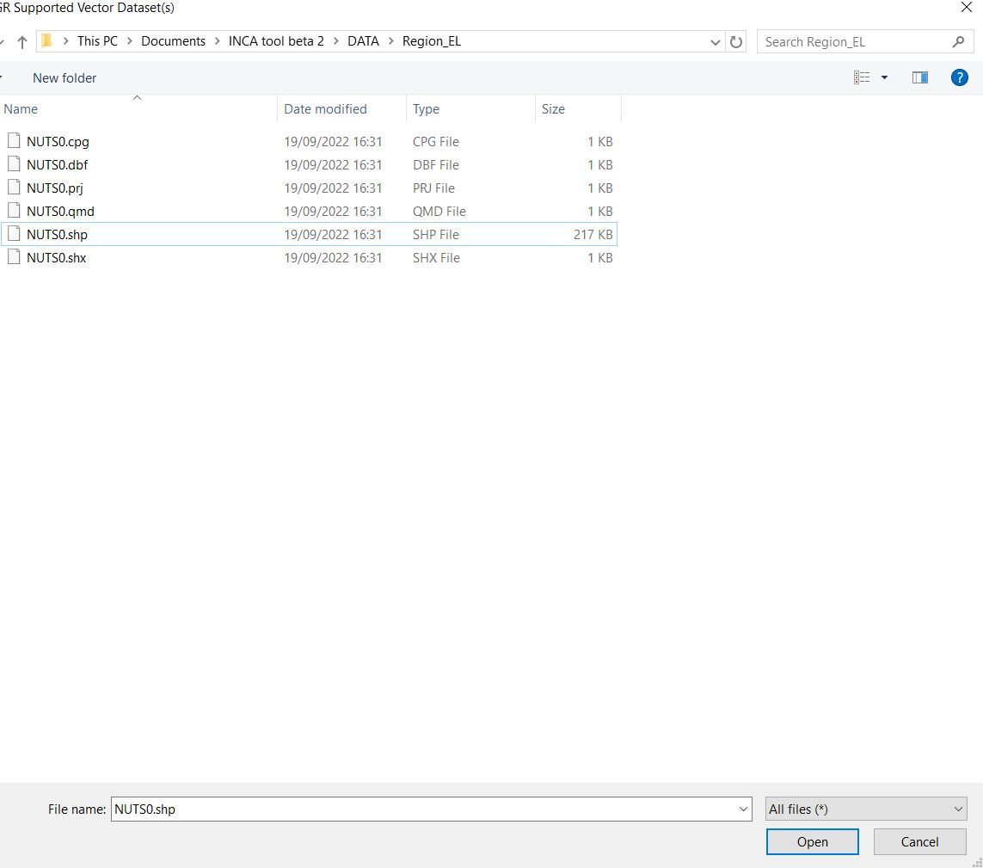
QGIS: adjust soil retention use visualisation
Navigate to ‘DATA’ > ‘Region_EL’ and select the NUTS0.shp file
Click ‘Open’
In the next window click ‘Add’ and then ‘Close’

Slide 46
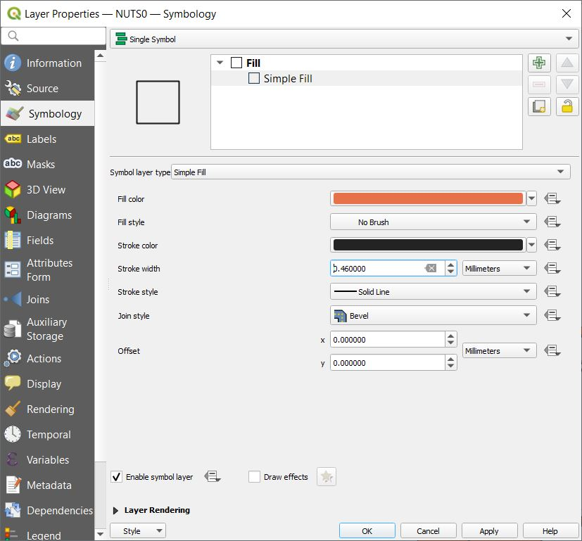
QGIS: adjust soil retention use visualisation
Right-click on the new ‘NUTS0’ layer, then ‘Properties’
Select ‘Symbology’
Select ‘Simple Fill’ and set the ‘Fill style’ to ‘No Brush’
Set ‘Stroke width’ to 0.46 milimiters
Click on ‘Apply’ and then ‘OK’

Slide 47
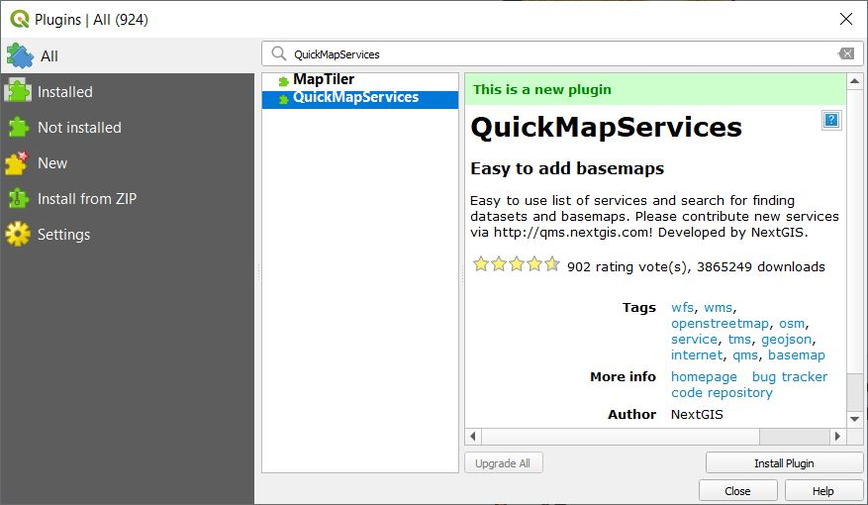
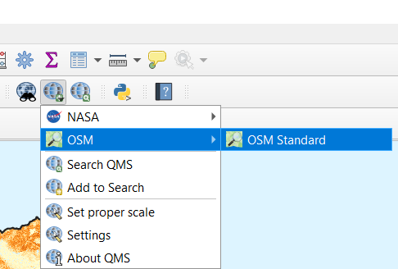
QGIS: adjust soil retention use visualisation
In the menu click on ‘Plugins’ then ‘Manage and Install Plugins...’
Select ‘All’
Search for ‘QuickMapServices’ and click ‘Install Plugin’ then ‘Close’
Look in the toolbar for the icon in the image and click on it, select ‘OSM’ then ‘OSM Standard’

Slide 48
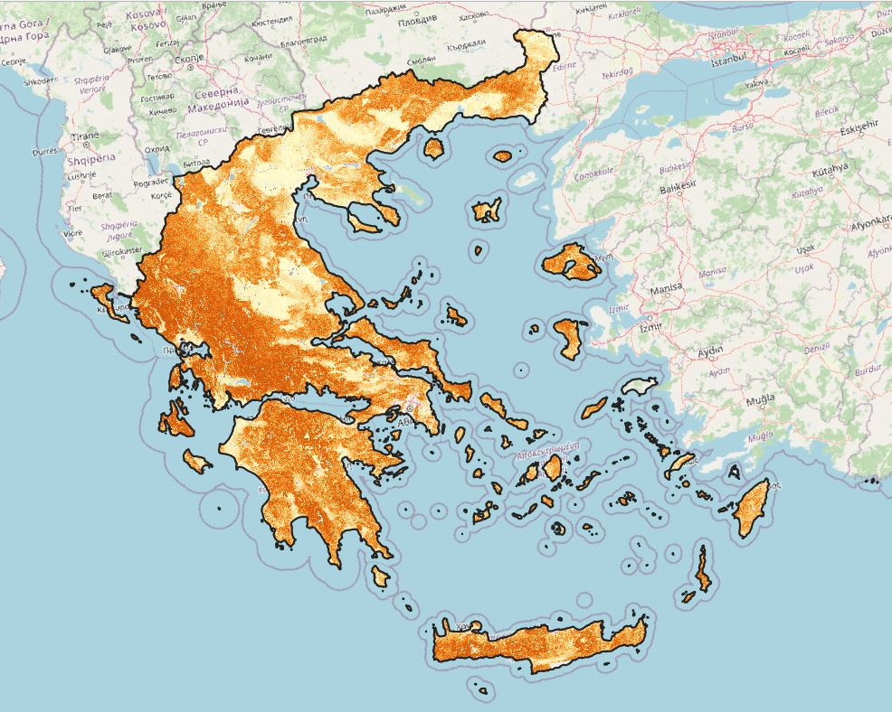
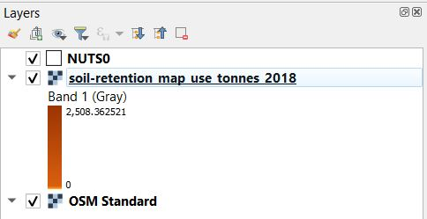
QGIS: adjust soil retention use visualisation
You have provided context to the map with the boundaries for Greece and the OpenStreetMap basemap
You should have these layers in this order:

Slide 49
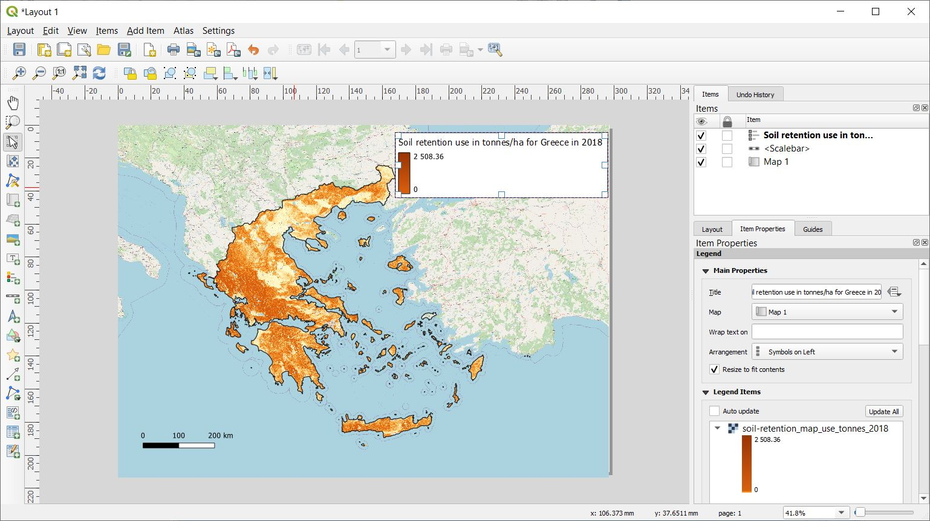
QGIS: adjust soil retention use visualisation
Select ‘Project’ from the menu and then click on ‘New Print Layout...’. It wll prompt you for a name, you can leave it empty
Click on the ‘Add map’ icon (green) and drag a rectangle across the page. The map will render
Click on the ‘Add Scale Bar’ icon (blue) and drag a rectangle in the page to place it
Click on the ‘Add Legend’ icon (red) and click on the page to place it
Go to ‘Item Properties’ of the legend and deselect ‘Auto update’
Remove all layers but the soil retention use layer, right-click on it and tick ‘Hidden’. Remove ‘Band 1’ as well
Double-click on the color ramp and set the height to 25 milimiters
Give a title to the legend
You can now export this as PDF, SVG or PNG (yellow)

Slide 50
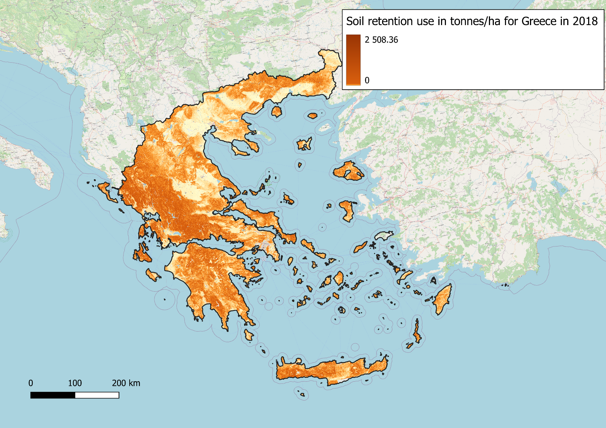
QGIS: adjust use of soil retention visualisation

Slide 51
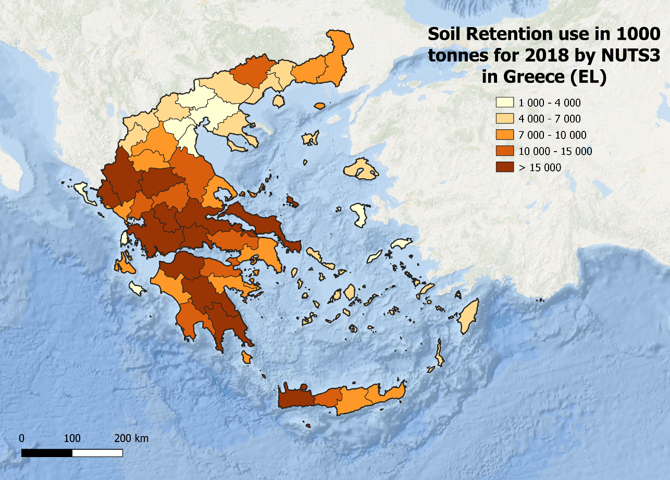
QGIS: zonal statistics by NUTS3 (Prefectures) – choropleth map
For the zonal statistics (found in the ‘Processing’ toolbox) use the ‘NUTS3_2010’ shapefile found under ‘DATA’ and as input raster, the ‘soil-retention_map_use_tonnes_2018’
Calculate only the ‘sum’
After runing, right-click on the output ‘Zonal Statistics’ layer and select ‘Properties..’
Under ‘Symbology’, select ‘Graduated’, for ‘Value’ set to ”_sum”/1000 and adjust visualisation parameters
This will produce a choropleth map in 1000 tonnes units by NUTS3 for Greece
Follow the previous steps for composing the final map for exporting
More info for zonal statistics: https://docs.qgis.org/3.22/en/docs/user_manual/processing_algs/qgis/rasteranalysis.html#zonal-statistics

Slide 52
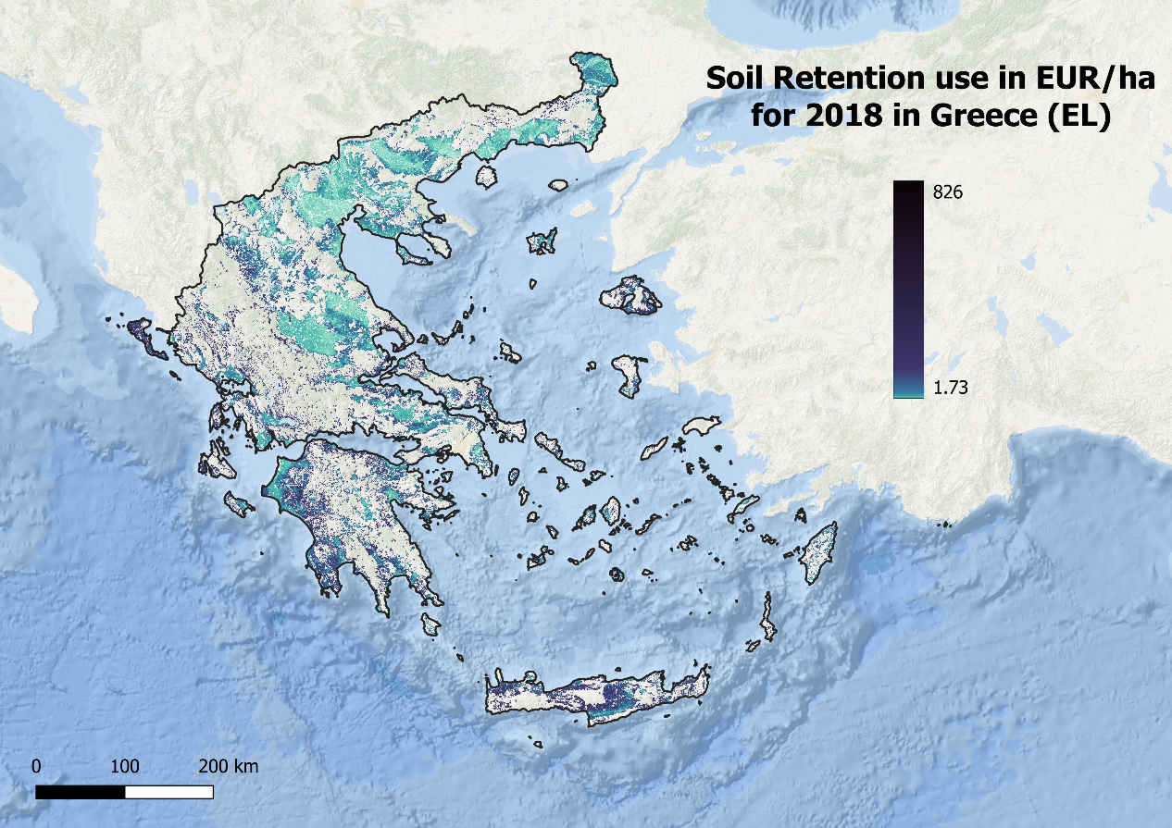
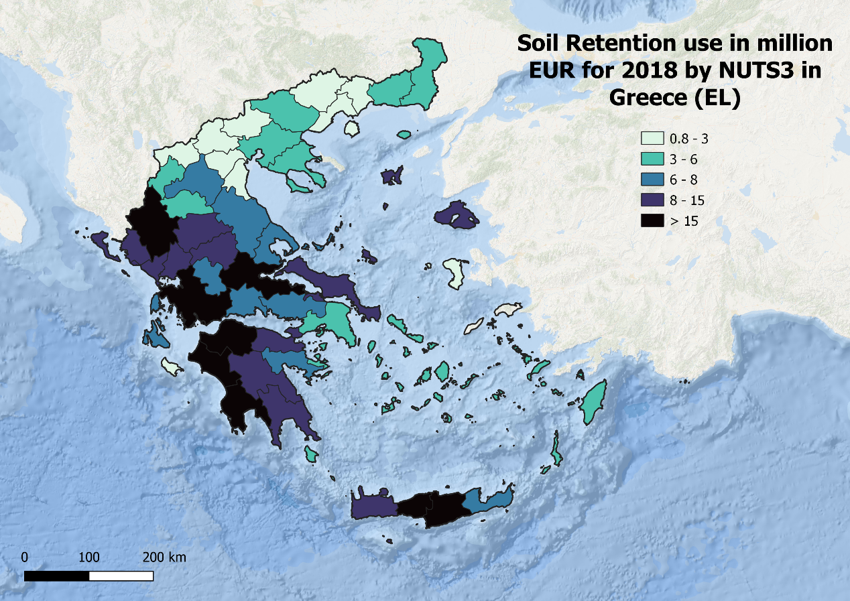
Maps for soil retention use in monetary terms

Slide 53


Maps for soil retention potential
For the choropleth map, the mean was used for calculating the zonal statistics as potential is a ratio

Slide 54


Maps for soil retention demand

Slide 55


Maps for soil retention mismatch

Slide 56

INCA: wood provision
Defined as the ecological contribution to the production of timber that can be harvested and used as a raw material
In terms of the ecological process, we need to refer to natural growth of a biotic resource
The service flow for accounting purposes is the net annual increment (NAI) of standing timber in forests that is available for wood supply
More info: “Ecosystem Services Accounting – Part III - Pilot accounts for habitat and species maintenance, on-site soil retention and water purification” – (page 100)
La Notte, A., Vallecillo Rodriguez, S., Garcia Bendito, E., Grammatikopoulou, I., Czucz, B., Ferrini, S., Grizzetti, B., Rega, C., Herrando, S., Villero, D., Zurbaran Nucci, M. and Maes, J., Ecosystem Services Accounting – Part III - Pilot accounts for habitat and species maintenance, on-site soil retention and water purification, EUR 30856 EN, Publications Office of the European Union, Luxembourg, 2021, ISBN 978-92-76-42051-4, doi:10.2760/636621, JRC126566.

Slide 57

INCA Tool: get familiar – wood provision
Specify a ‘Working directory’. All the outputs of the model will be stored there. Make sure QGIS has access to this directory.
The ‘ Study Scope’ defines the year(s), shapefile for the regions, land cover map (raster) to delimit the extent of ecosystems and the classification (table).
You can keep these settings fixed for different models.
Select an ‘Ecosystem Service’ model to run. Let’s select now ‘wood_provision’. Parameters below will adjust depending on this selection.
This will be the name of the output folder of the model. Make sure this folder doesn’t exist if you’re doing a first run for the model - which is the case!
Required inputs for the model selected. We will use the default data used for the calculation of EL (Greece) for 2018.

Slide 58

INCA Tool: explore the DATA – wood provision
Data provided for this model covers the EU but when limiting to the EL (Greece) Region, the plugin will crop the outputs only to show this country

Slide 59








INCA Tool: wood provision inputs
You may find all the required inputs in the ‘input_model’ folder under DATA > input_model_woodprovision >
Note that the shapefile for the Region does not change, this file is under ‘DATA’
After all inputs are in place you are ready to run the model!
Use .shp extenshion
Optional when using CORINE Accounting Layers – let’s leave it empty

Slide 60

INCA Tool: wood provision – explore results

Slide 61


Supply and use tables in biophysical terms
Supply
Use

Slide 62


Supply and use tables in monetary terms
Supply
Use

Slide 63


Maps for wood provision use

Slide 64


Maps for wood provision use in monetary terms

Slide 65


More information
Tuesday 11 Oct
11:00 – 15:30 T17b/c (Room Park)
https://oneecosystem.pensoft.net/article/85389/

Slide 66

Thank you
Questions?
Contact me: mayra.zurbaran-nucci@ext.ec.europa.eu
@mazucci

